Slide 1
For Website: Supplementary material to description of landmarks and publications in work in Gastroenterology & liver diseases
Dr Avnish Seth

Slide 2
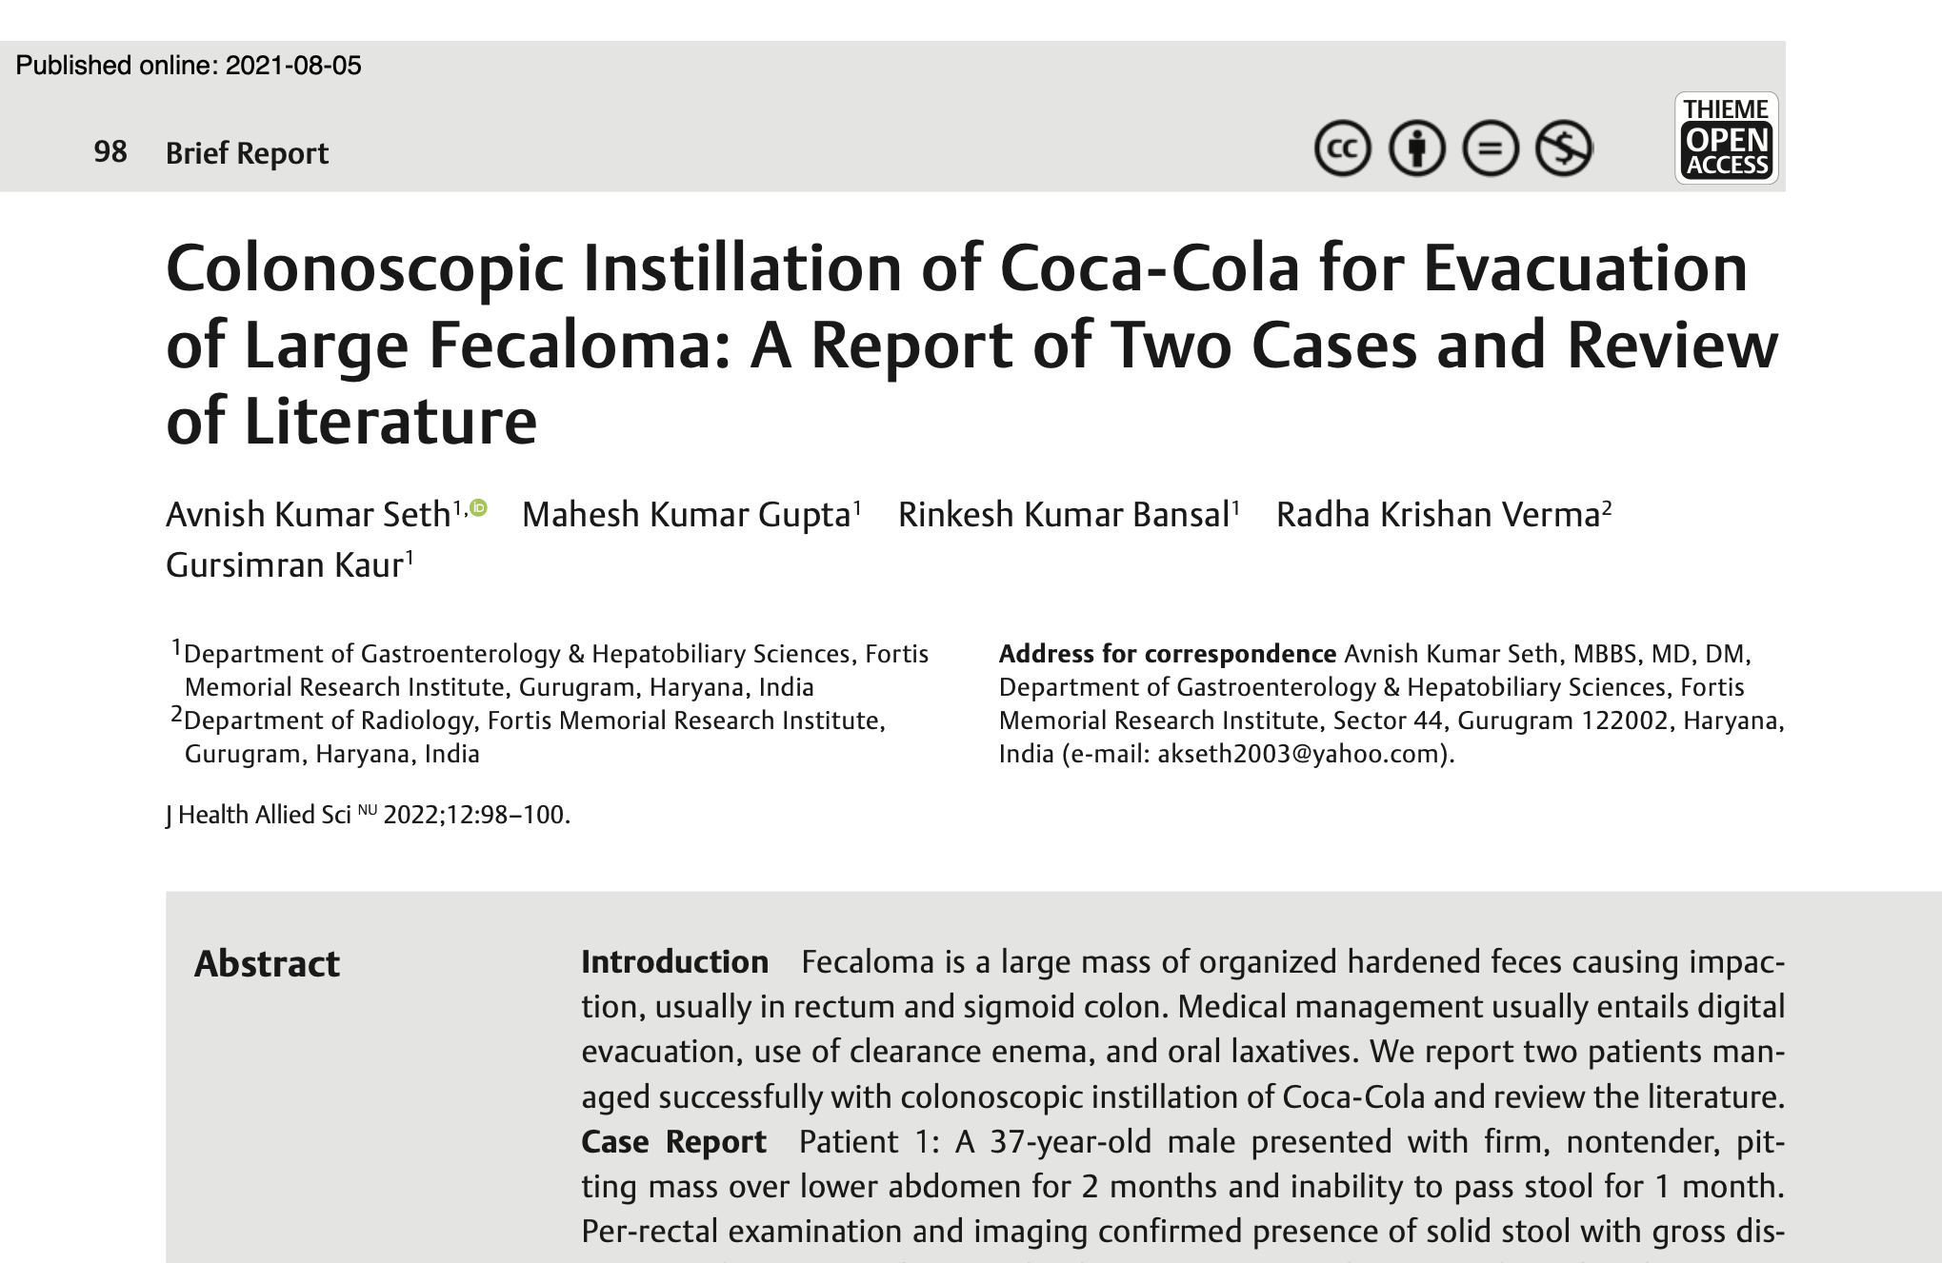

Slide 3
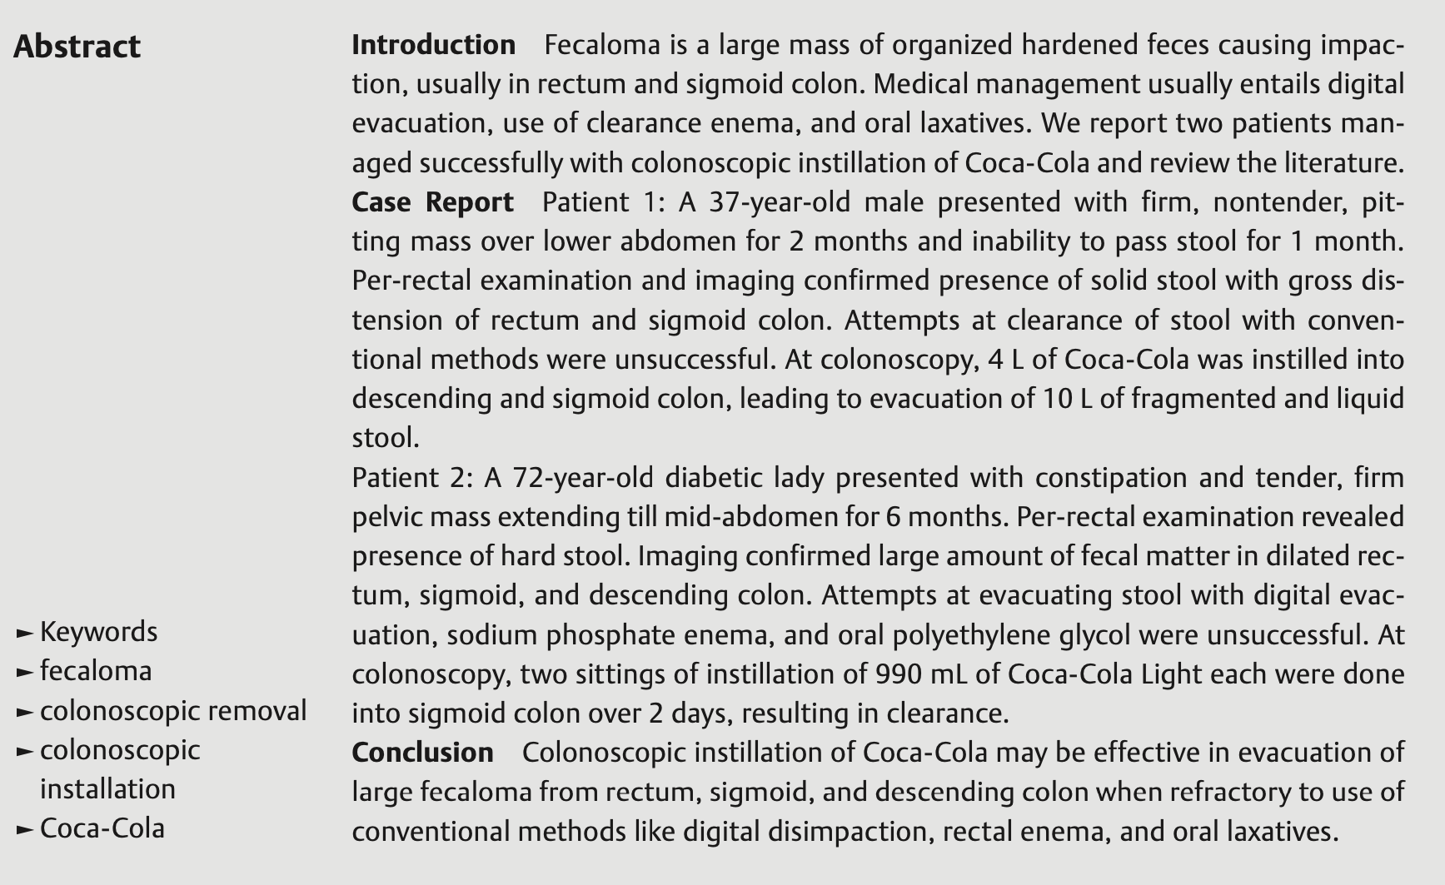

Slide 4
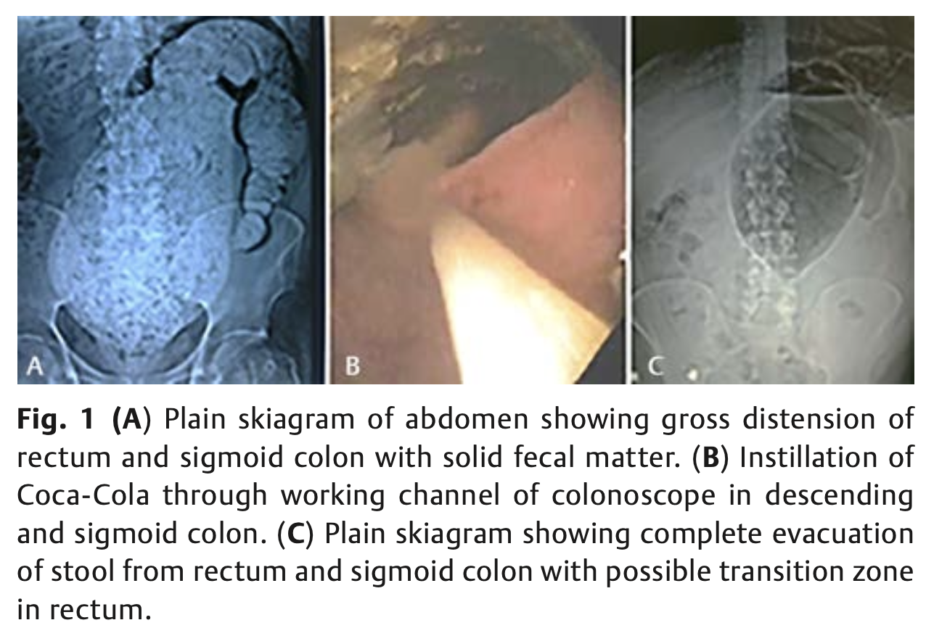
(Seth Avnish et al, J Health Allied Sci 2022)

Slide 5
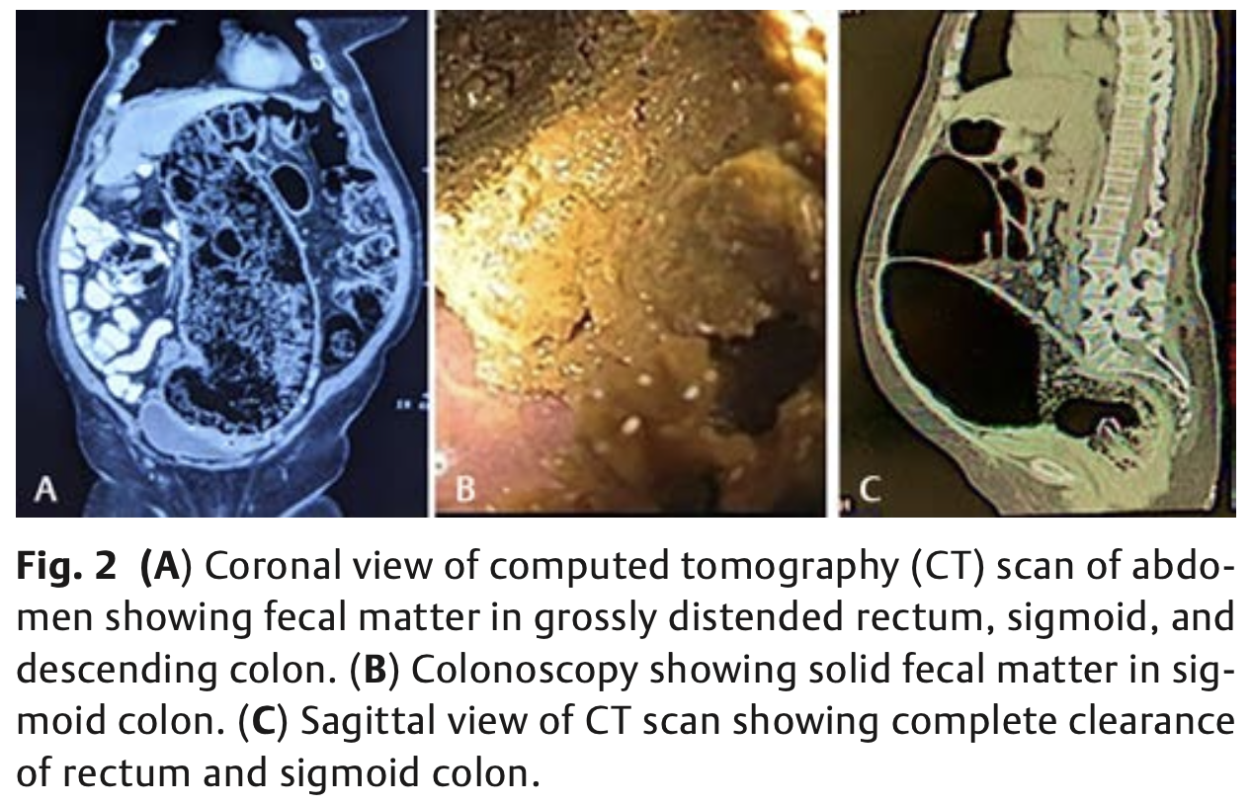
(Seth Avnish et al, J Health Allied Sci 2022)

Slide 6
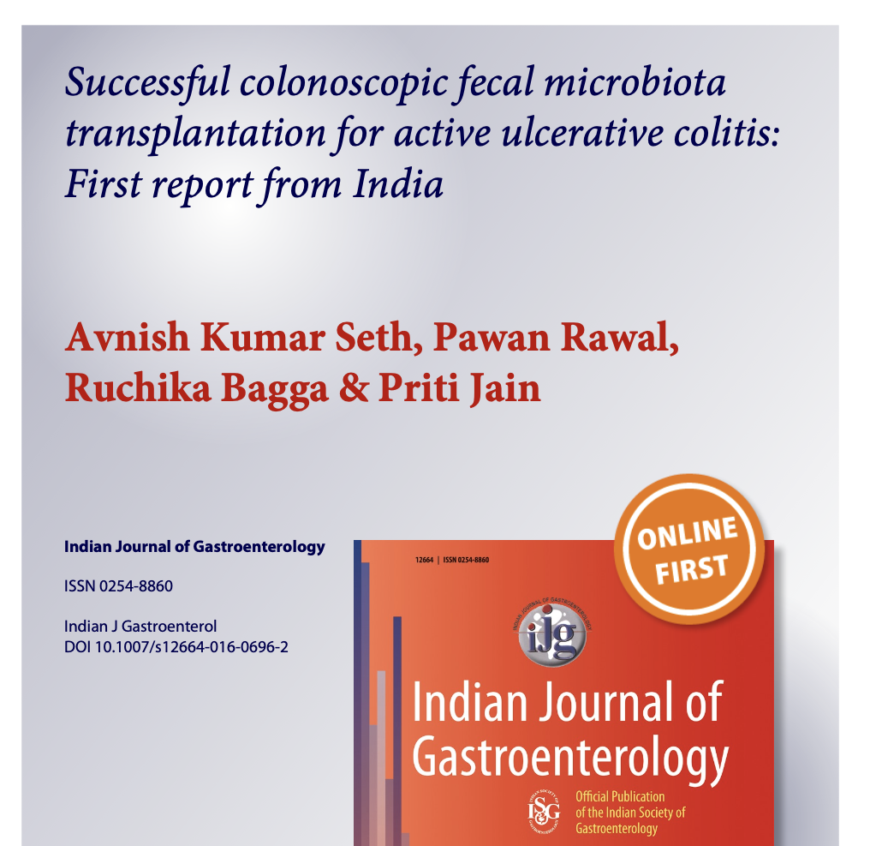

Slide 7
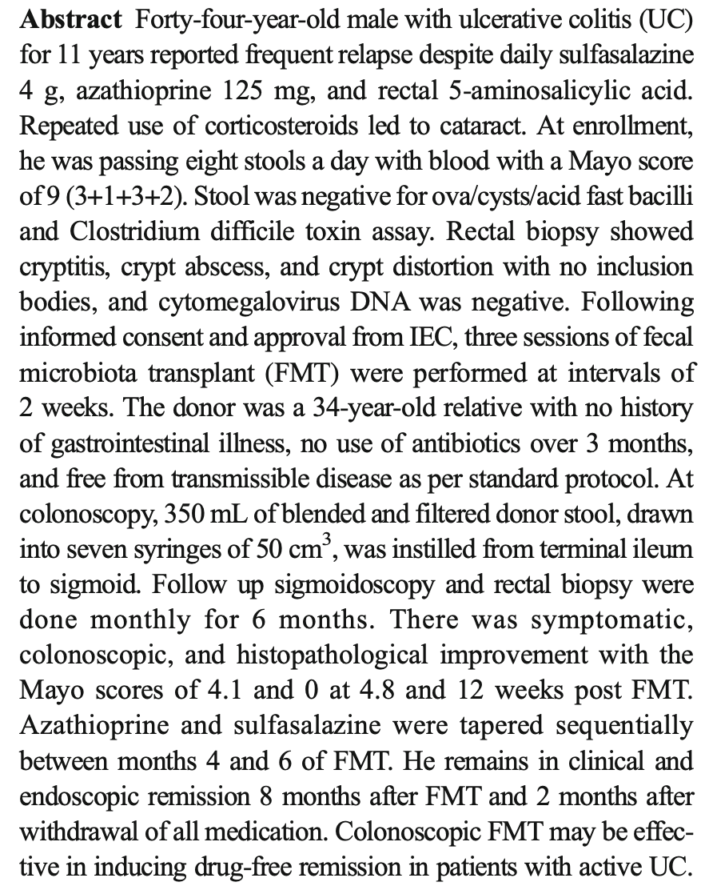

Slide 8
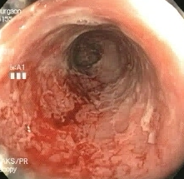
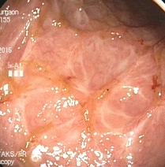
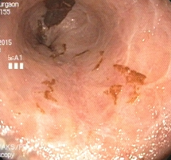
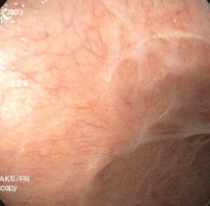
Colonoscopic Response
At recruitment
At 4 weeks
At 12 weeks
At 24 weeks
Notes:
Nov, jan, mar, jun

Slide 9
Response to FMT: Mayo Score
Mayo
Score
FMT 1
FMT 2
FMT 3
In weeks

Slide 10
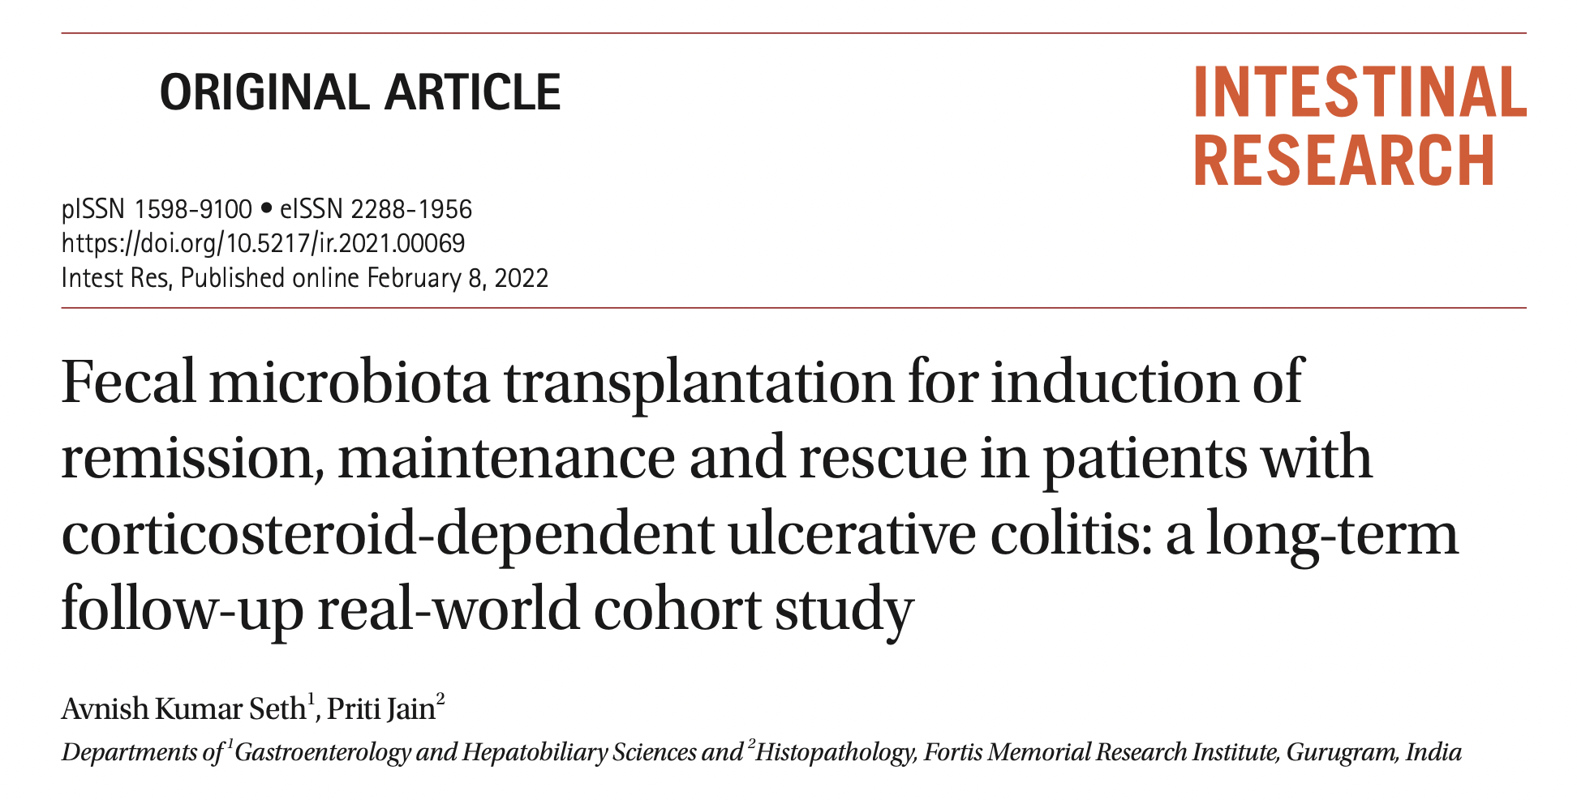

Slide 11
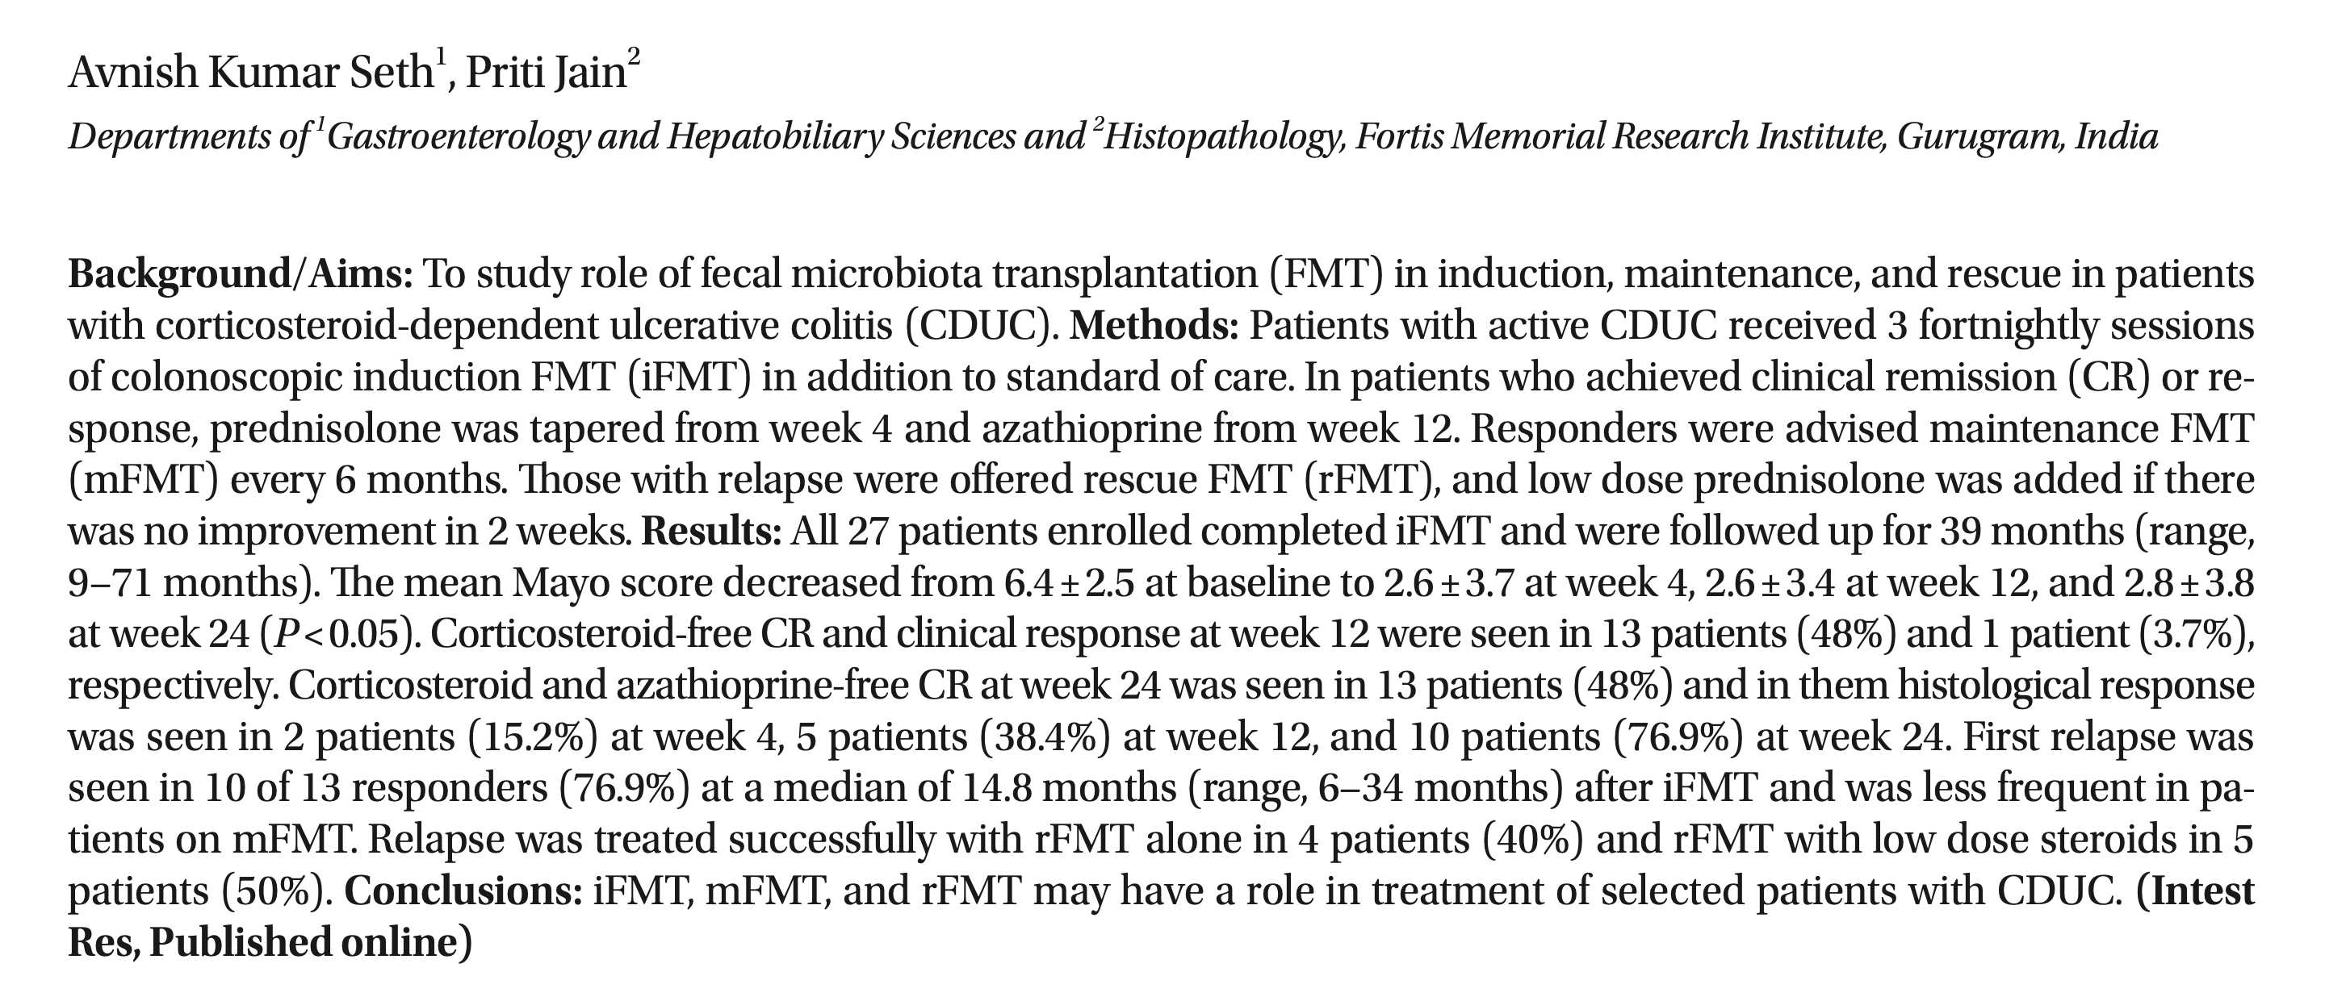
Stool transplant for Ulcerative Colitis: Real-world 5-year follow up study
(Intestinal Research 2022)

Slide 12
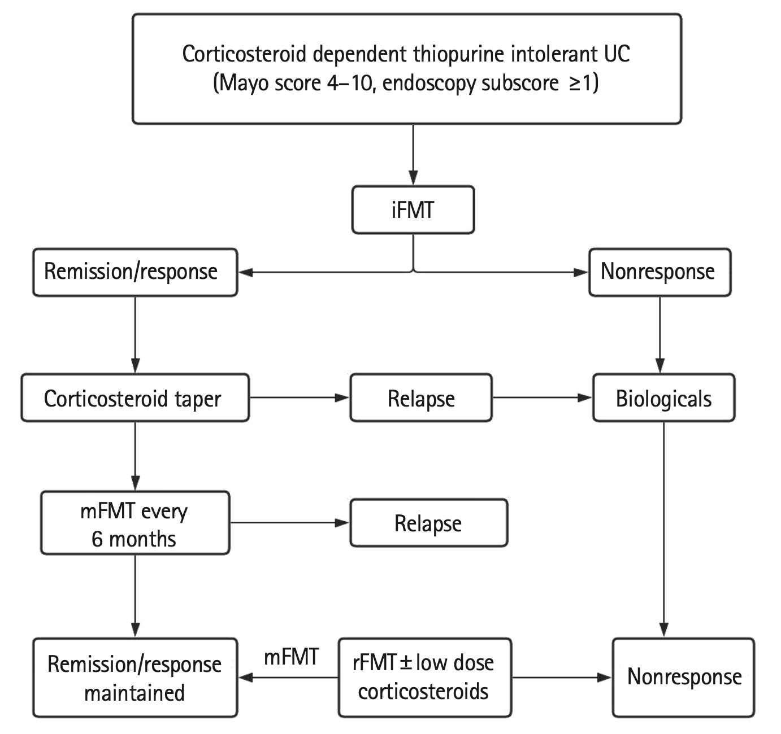
First description of Induction (iFMT), Maintenance (mFMT) and Rescue (rFMT) for Ulcerative Colitis
(Seth AK et al. Intestinal Research 2022)

Slide 13
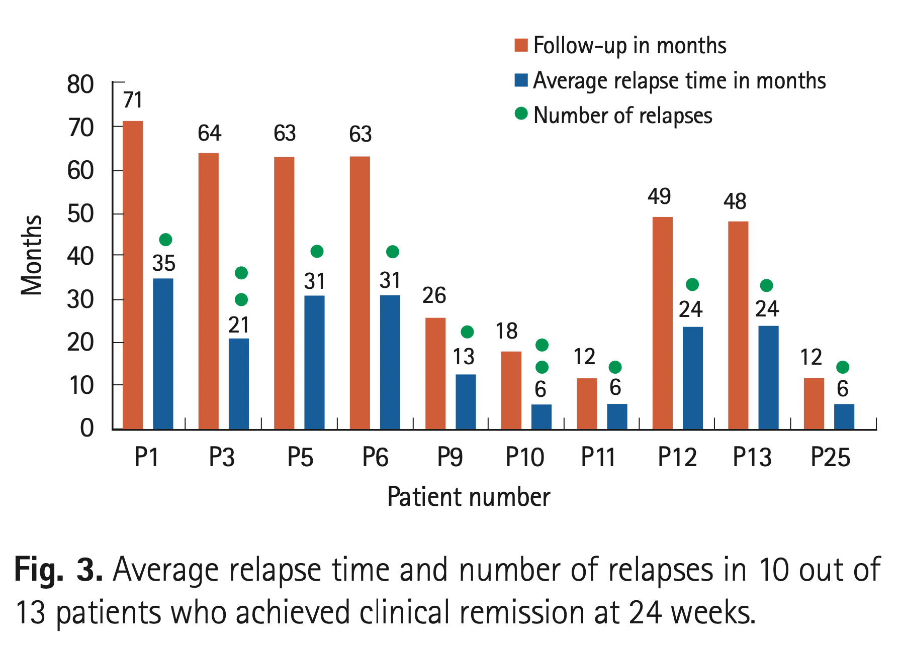
(Seth AK et al. Intestinal Research 2022)

Slide 14
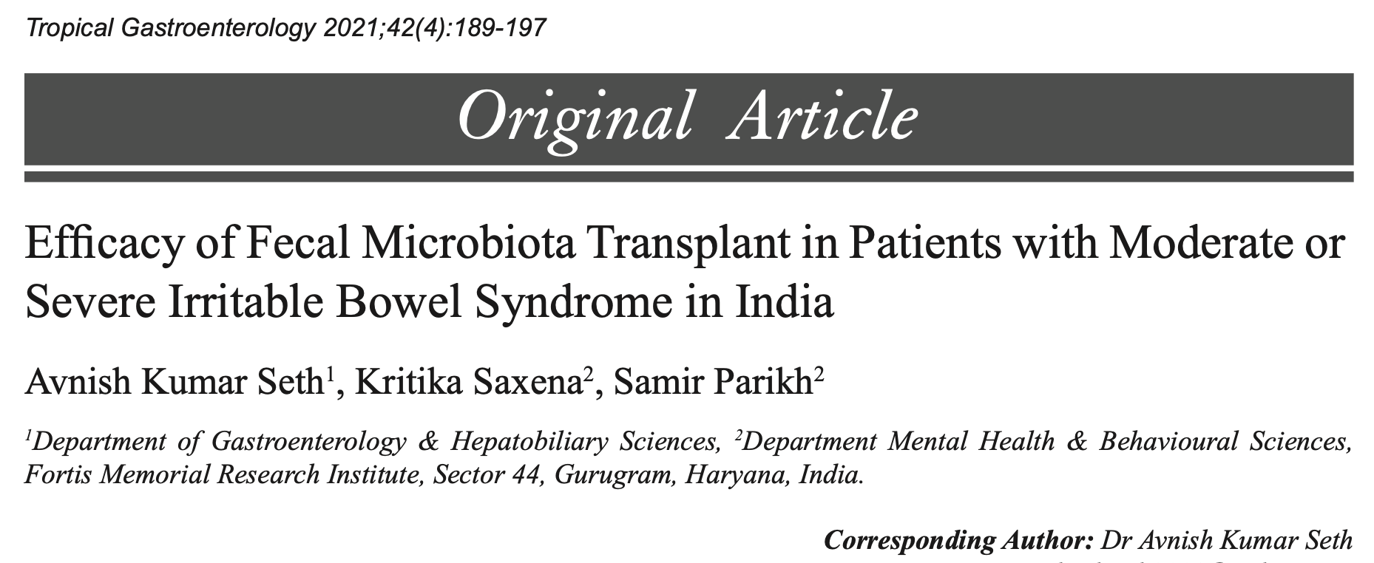

Slide 15
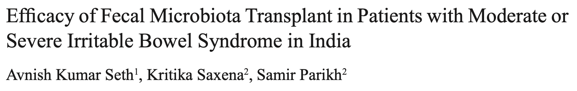
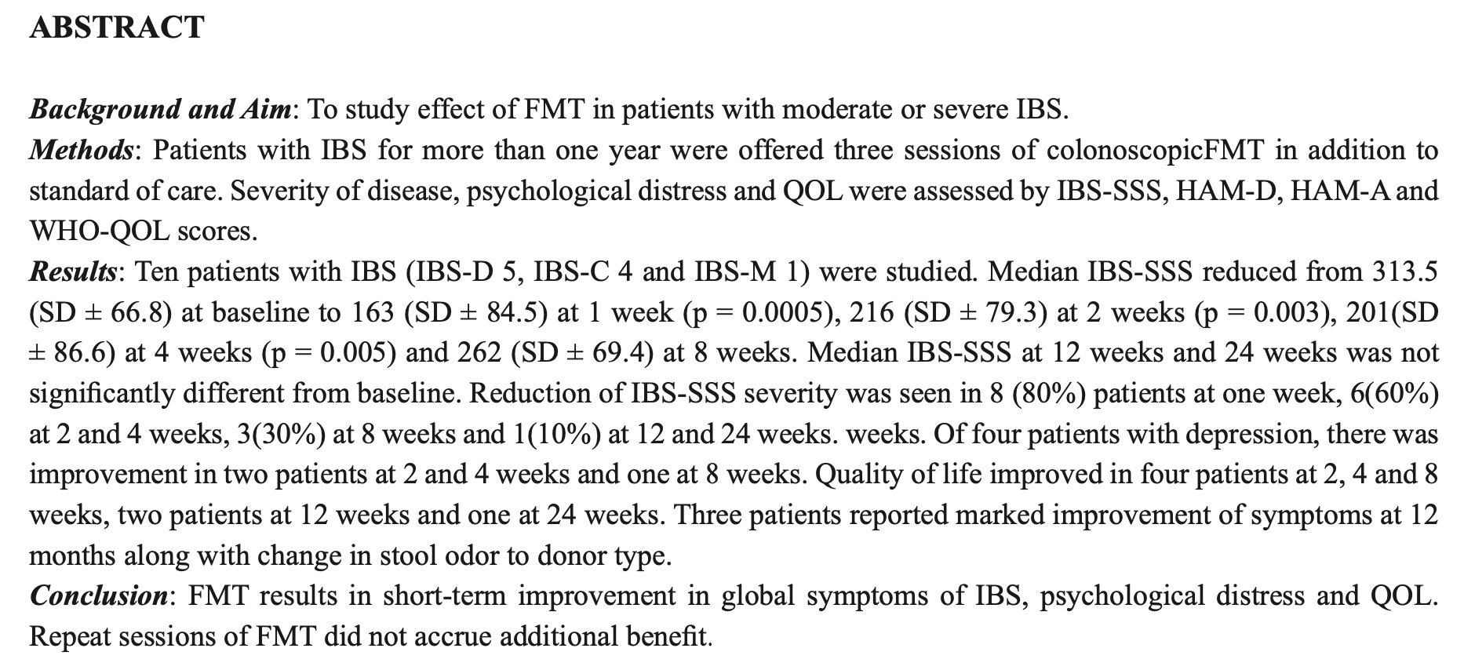

Slide 16
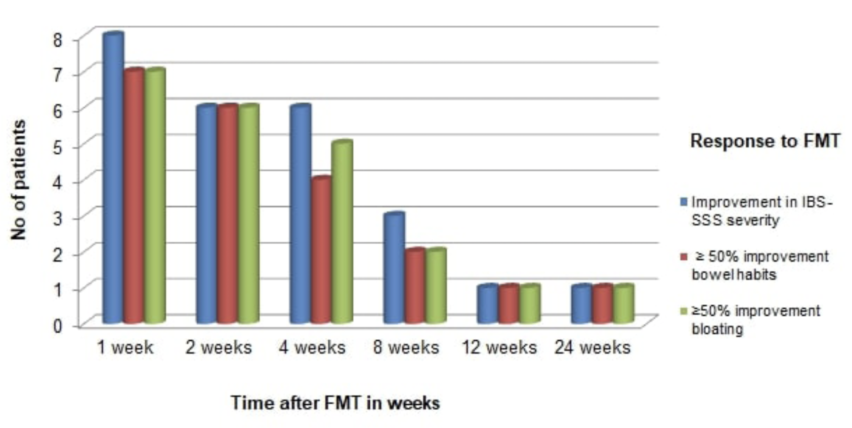
FMT for Irritable Bowel Syndrome
(Seth AK et al. Tropical Gastro 2021)

Slide 17
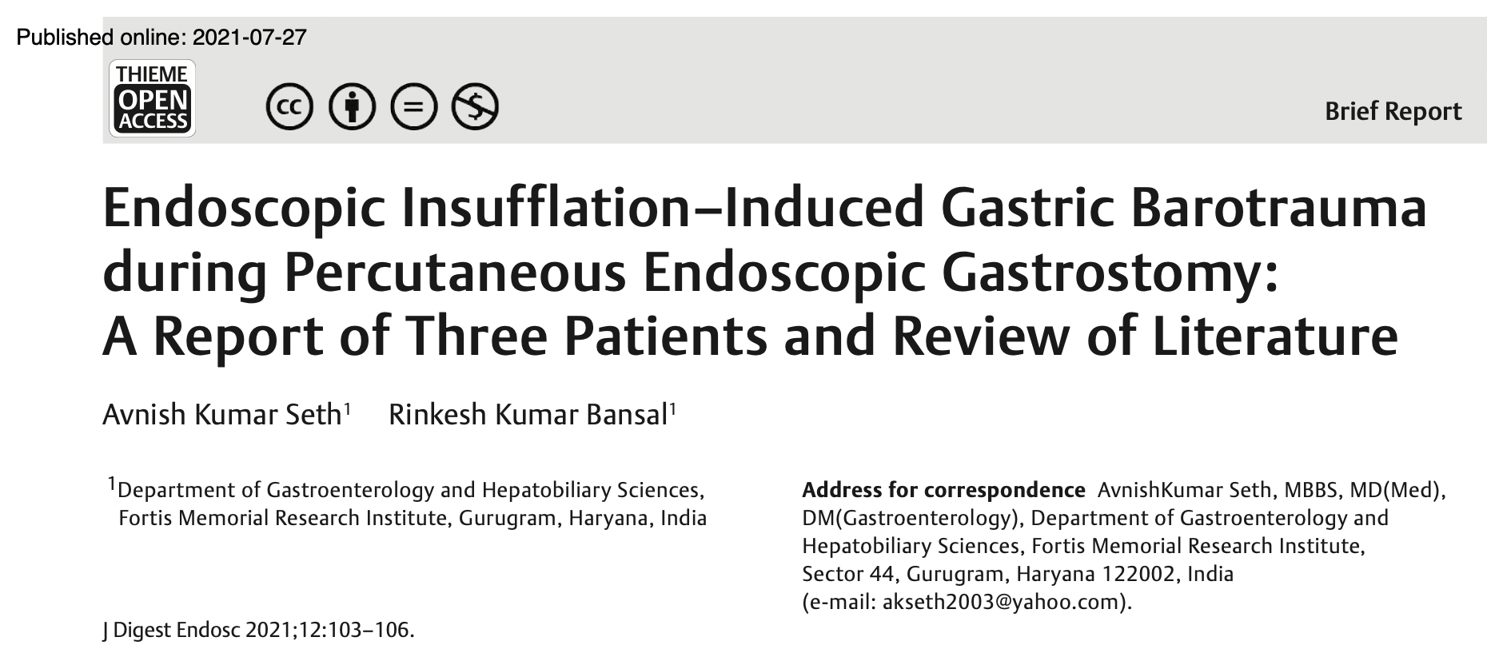

Slide 18
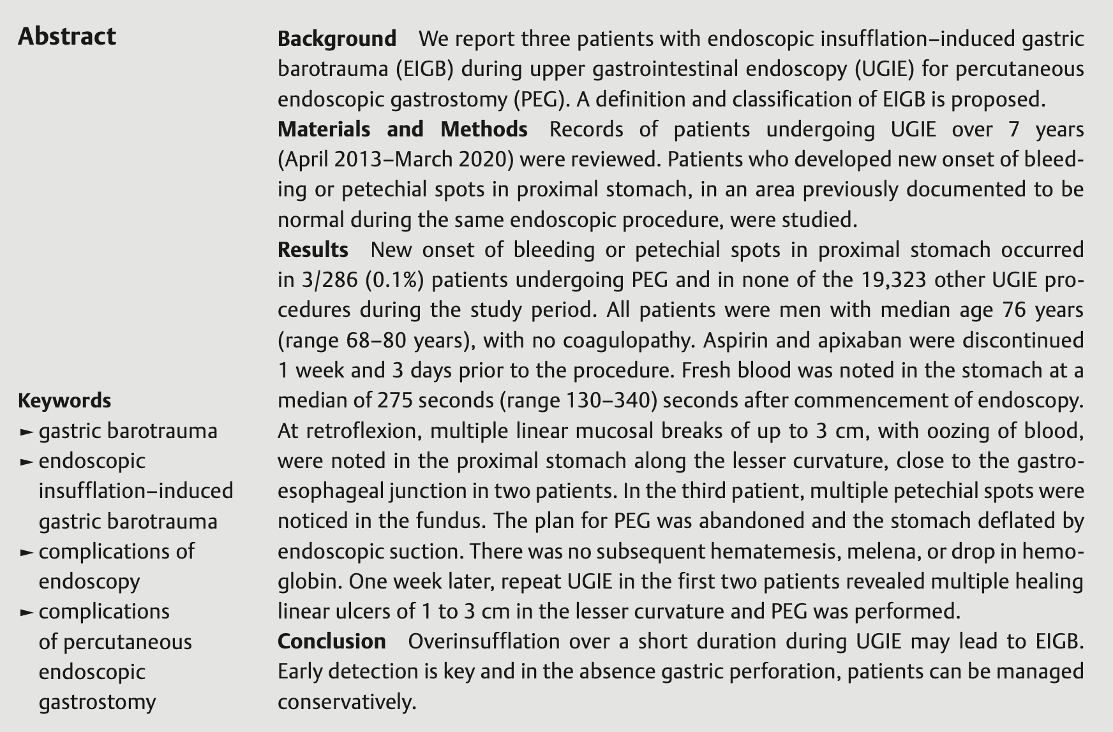
(Seth AK et al. J Digestive Endoscopy 2021)

Slide 19
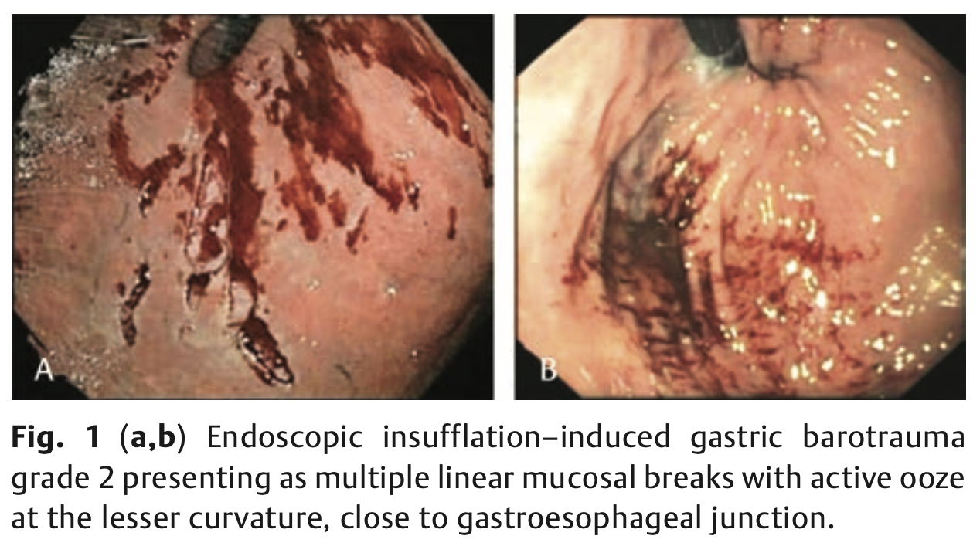
(Seth AK et al. J Digestive Endoscopy 2021)

Slide 20
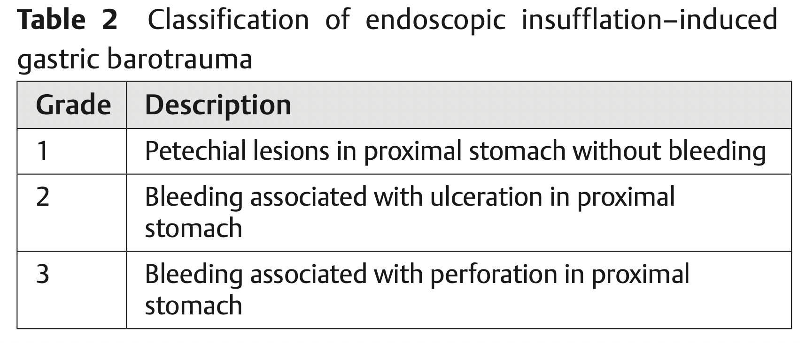
(Seth AK et al. J Digestive Endoscopy 2021)

Slide 21
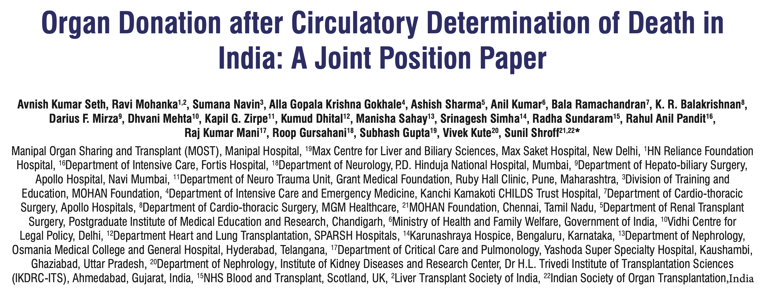

Slide 22
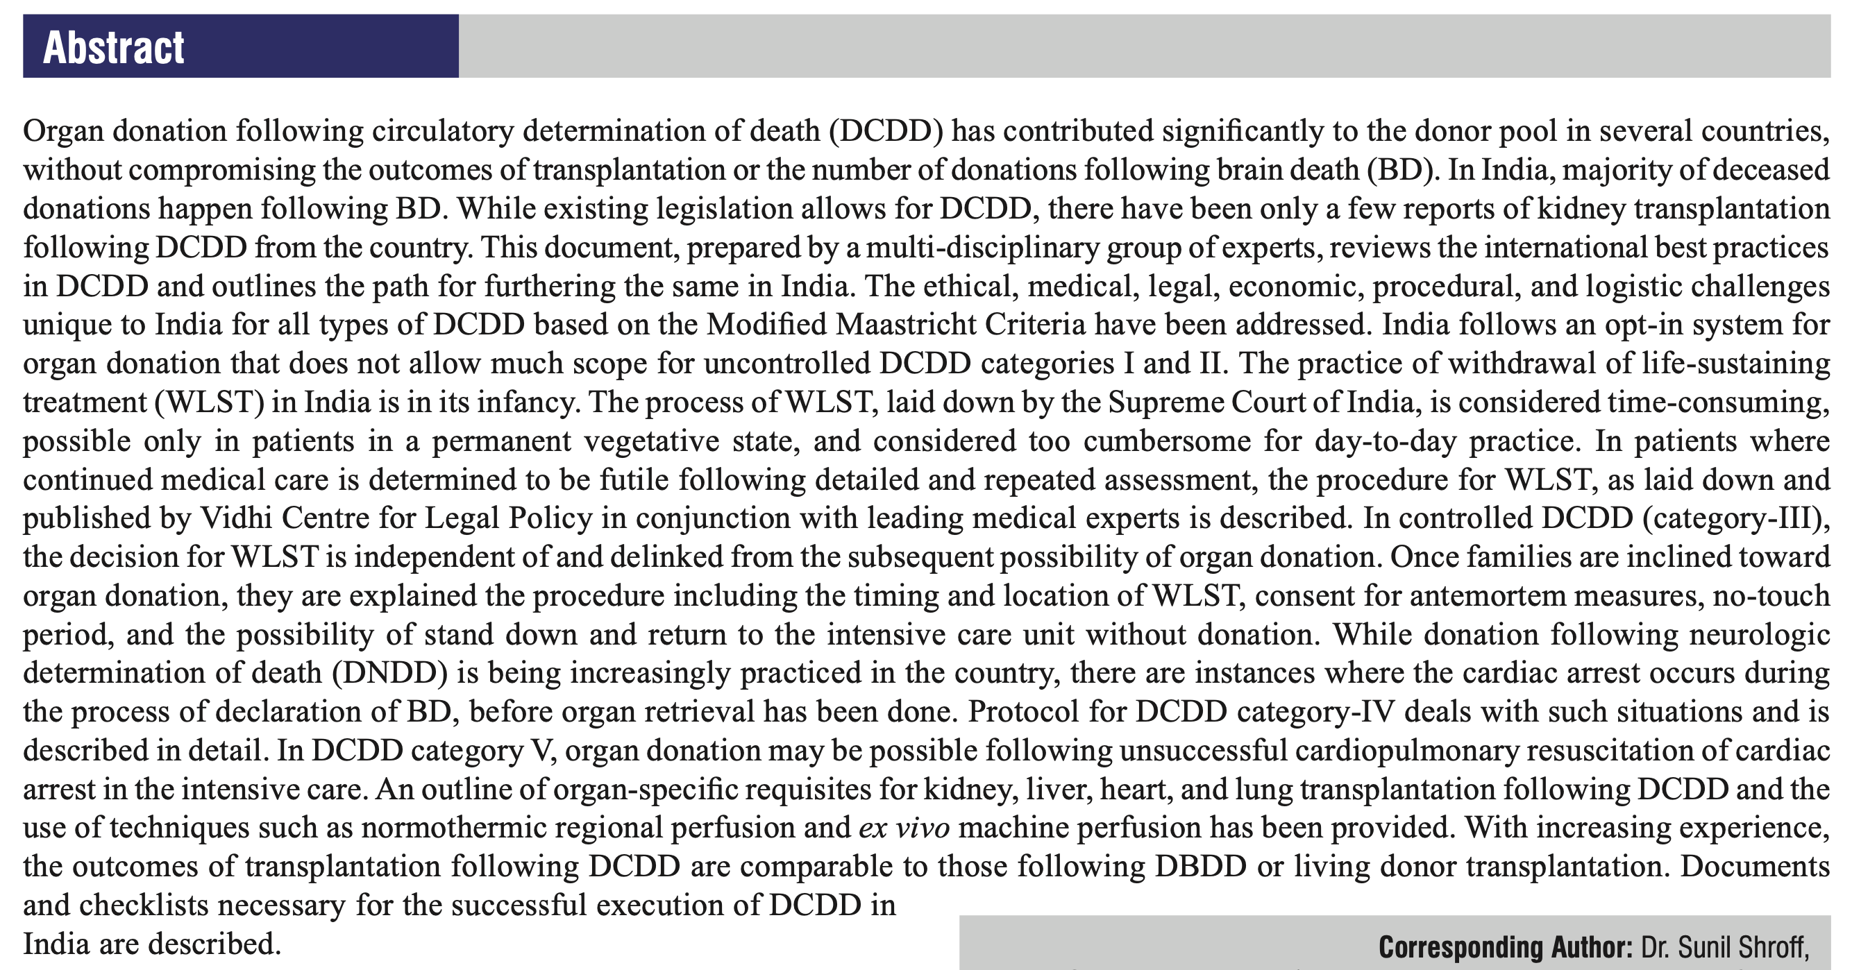
(Seth AK et al. Indian J Transplantation 2022)

Slide 23
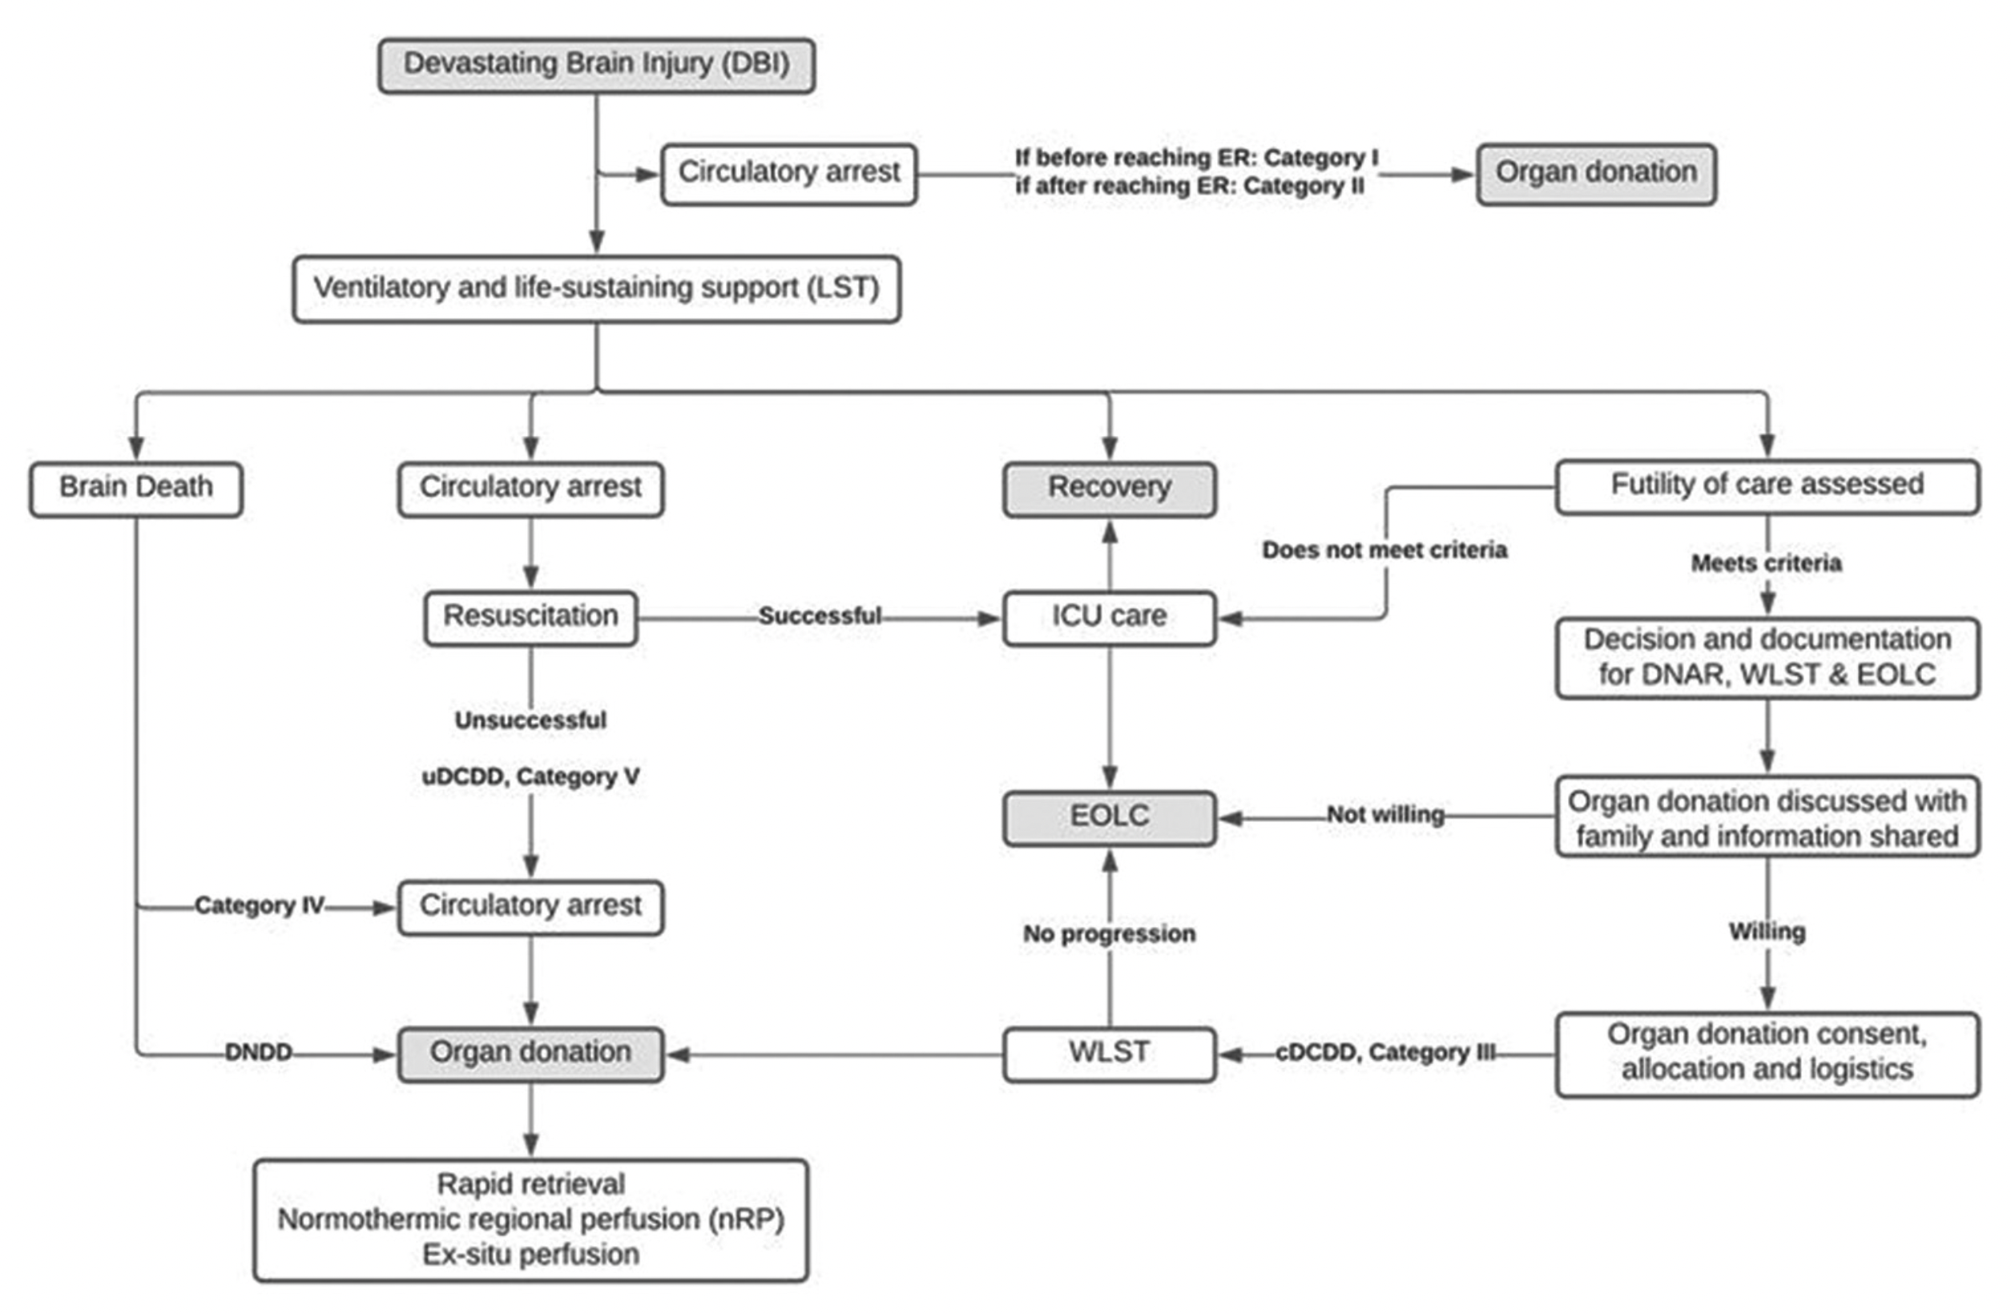
(Seth AK et al. Indian J Transplantation 2022)

Slide 25
